Slide 1
Azure Infrastructure as Code Bootcamp
Session 2 of 6: Azure Compute Services
Session materials repository: timw.info/inebootcamp

Slide 2

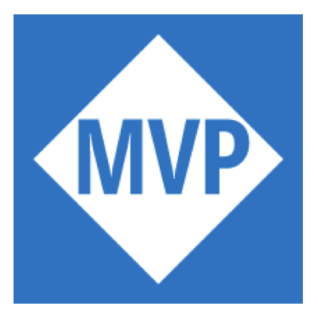
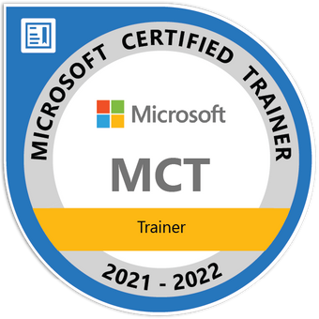
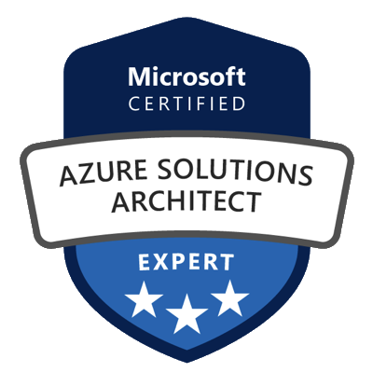
Tim Warner
timothywarner316@gmail.com
@TechTrainerTim
timw.info/linkedin

Slide 3
Bootcamp Overview
Session 1: Infrastructure as Code
Session 2: Azure Compute Services
Session 3: Azure Network Services
Session 4: Azure High Availability & Fault Tolerance
Session 5: Azure Storage Services
Session 6: Identity and Access Management

Slide 4
Session 2 Agenda
Day 1
Azure compute services tour
Azure Virtual Machines
Day 2
Azure App Service
Day 3
Azure Container services

Slide 5
Azure Compute Services Tour

Slide 6
Azure Compute Service Family
Azure Virtual Machines
VM Scale Sets (VMSS)
Azure Batch

Slide 7
Azure Compute Service Family
Azure App Service
Web Apps
Functions
Logic Apps

Slide 8
Azure Compute Service Family
Azure Container Registry (ACR)
Azure Container Instance (ACI)
Azure Kubernetes Service (AKS)

Slide 9
Azure Virtual Machines

Slide 10
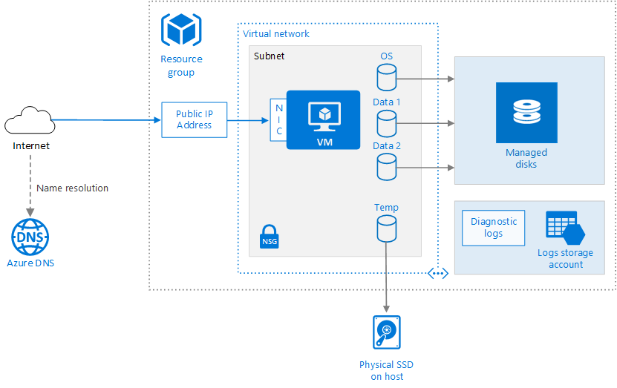
Azure Virtual Machines
timw.info/hyd

Slide 11
Demo 1 of 2: VM Deployment and Configuration

Slide 12
Virtual Machine Scale Sets

Slide 13
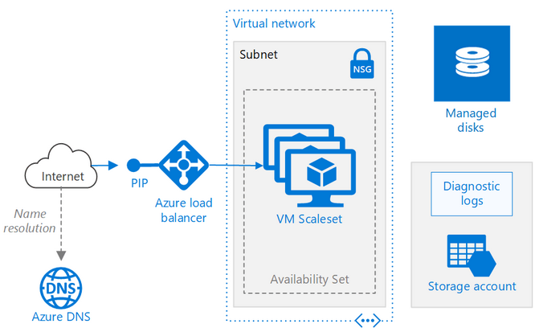
Virtual Machine Scale Sets
timw.info/xep

Slide 14
Azure Batch

Slide 15
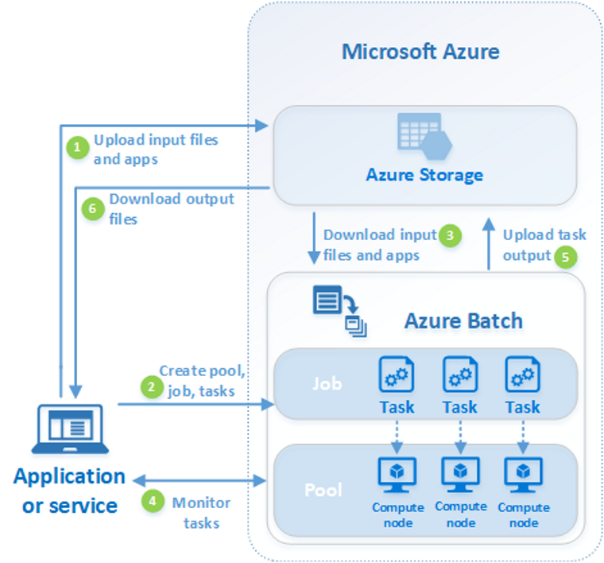
Azure Batch
timw.info/c0q

Slide 16
Demo 2 of 2: VMSS Deployment and Configuration

Slide 17
Azure App Service Tour

Slide 18
Azure App Service Family
Web Apps
Functions
Logic Apps
API Management

Slide 19
Azure App Service

Slide 20
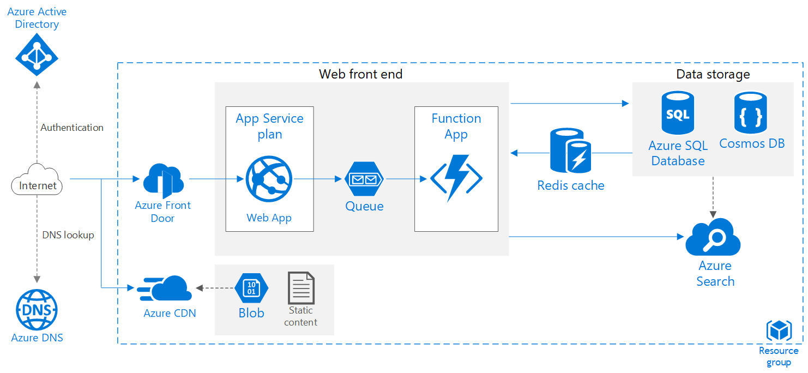
Azure App Service
timw.info/ftz

Slide 21
Demo 1 of 2: Deploy and Manage Azure Web Apps

Slide 22
Azure Functions

Slide 23
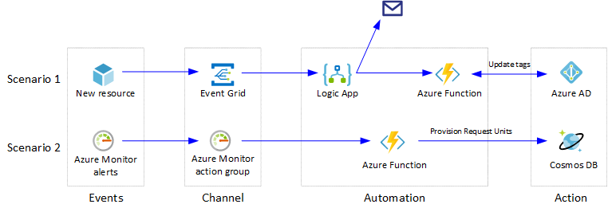
Azure Functions
timw.info/u85

Slide 24
Demo 2 of 2: Deploy and Manage Azure Functions

Slide 25
Azure Container Services Tour

Slide 26
Azure Container Services Family
Azure VM container hosts
Azure Container Registry (ACR)
Azure Container Instances (ACI)
Azure Kubernetes Service (AKS)

Slide 27
Azure Container Registry

Slide 28
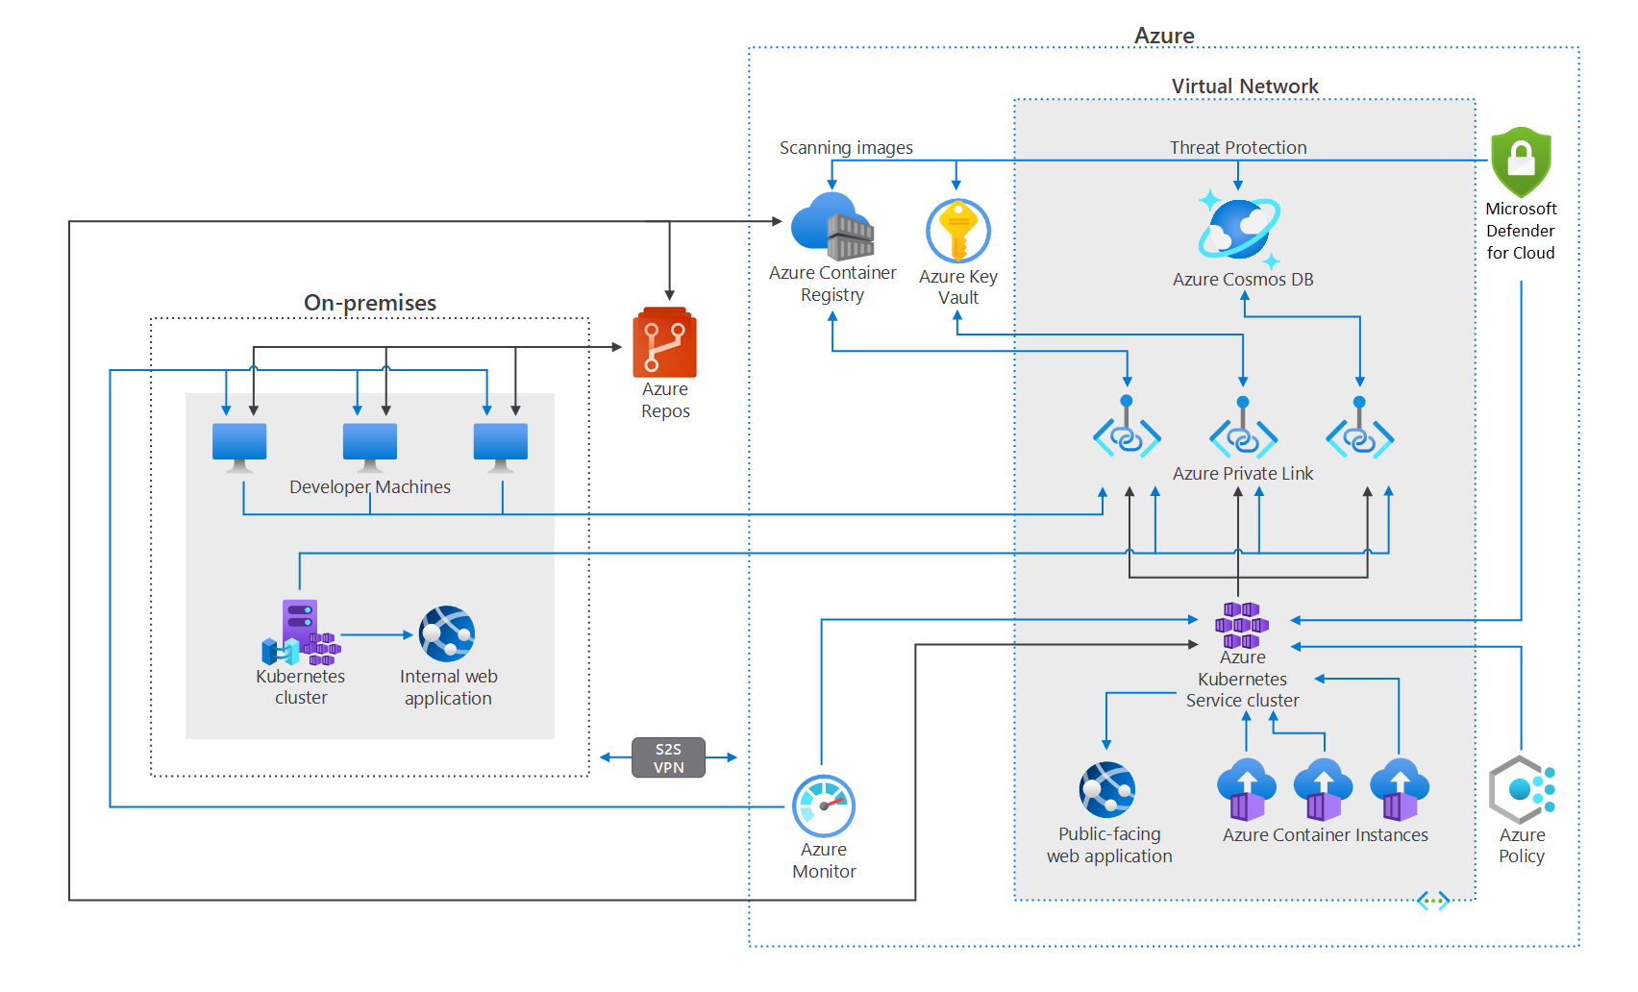
Azure Container Registry
timw.info/n5w

Slide 29
Demo 1 of 2: Deploy and Manage Azure Container Registry

Slide 30
ACI & AKS

Slide 31
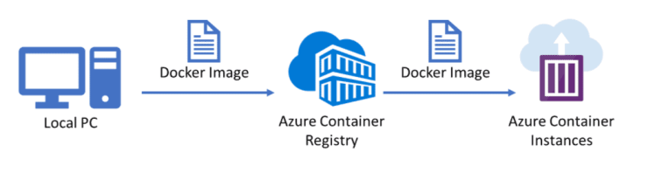
Azure Container Instances
timw.info/4da

Slide 32
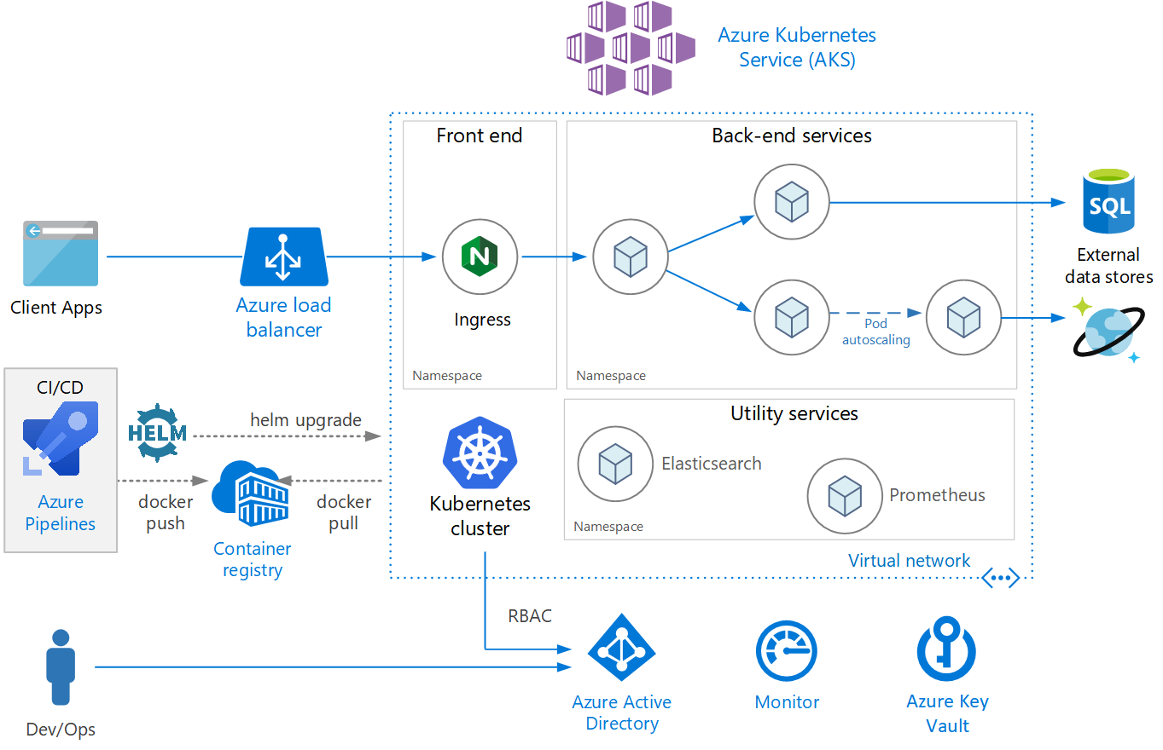
Azure Kubernetes Service
timw.info/1uv

Slide 33
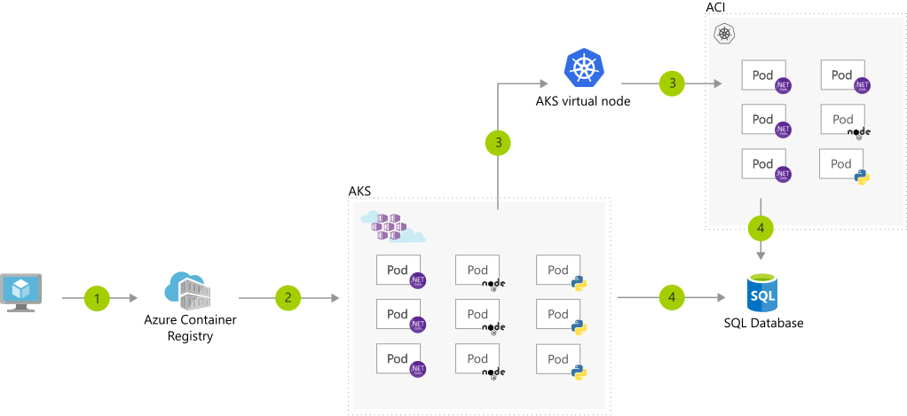
AKS + ACI
timw.info/d9z

Slide 34
Demo 2 of 2: Deploy and Manage ACI and AKS

Slide 35
Coming up...
Session 3: Azure Network Services
Connectivity: VNets, VPNs, DNS, Bastion
App Protection: Load Balancer, NSGs, Firewall, Private Link
App Delivery: App Gateway, Traffic Manager, Front Door

